Slide 1
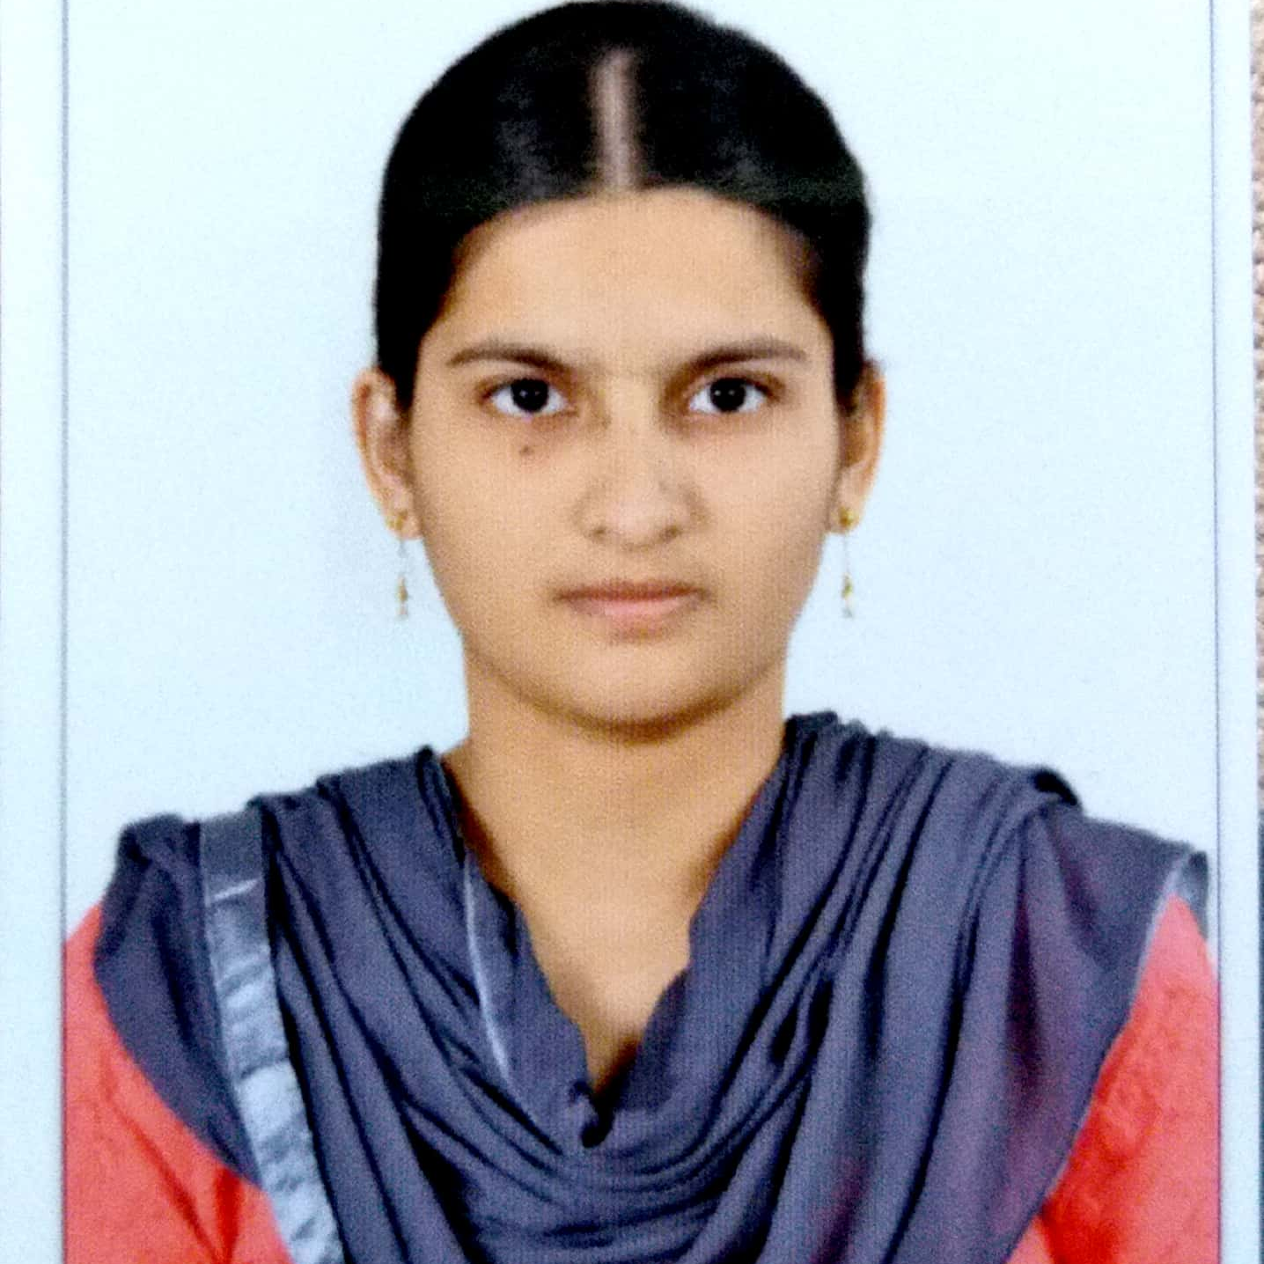


Ayesha Fathima Mohammed
Bachelor of Technology
Computer Science : 2016 - 2020
Skills Java 8 /J2EE
Spring Boot
Spring MVC
Database
SQL database – MySQL
No SQL database – MongoDB
Web Technologies
HTML5
CSS3
Javascript
AddOns
Github
Maven
Postman
Analyst/Software Engineer
Bangalore
ayesha-fathima.mohammed@capgemini.com
+91-9494478786
A4
Software Engineer who is Strong in design and integration with intuitive problem-solving skills. Passionate about implementing and launching new projects.
Ready to learn new technologies and implement them to further improve my knowledge.
Eager to work in a team of dedicated people and serve a key role in the enhancement and development of the project.
Has working knowledge on Java Microservice Development using Spring framework and Angular Framework on an intermediate level.
Flight Booking System
Completed end to end case study of Flight Booking System along with JWT authentication, Swagger, Angular Material-UI and Bootstrap used for user interface.
AWS Certified Cloud Practitioner
Ocean Certified as Java Entry Level Developer -
Level : I, II

